Slide 1
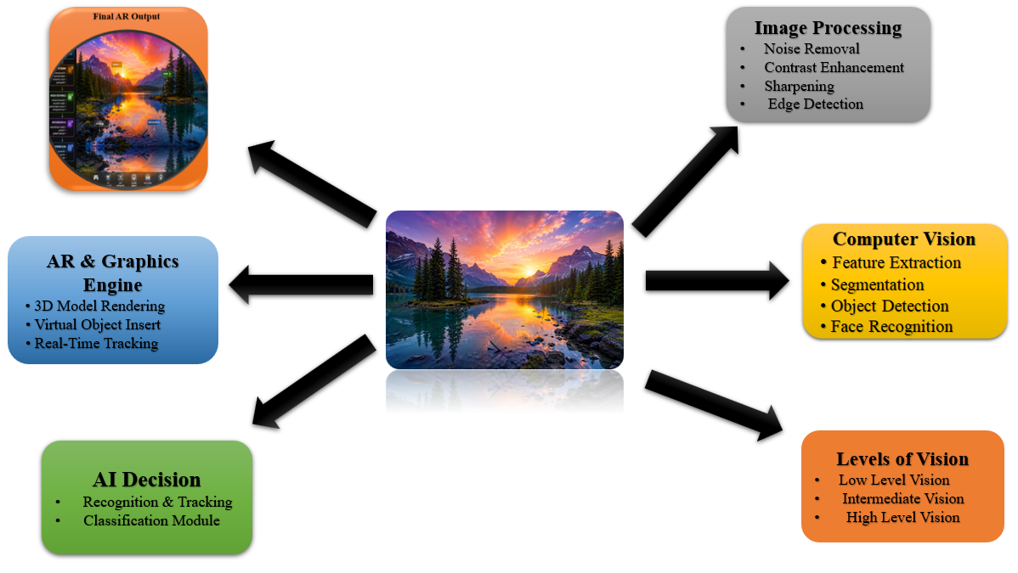
System architecture of developing a smart photo editing + object recognition + AR app

Slide 2
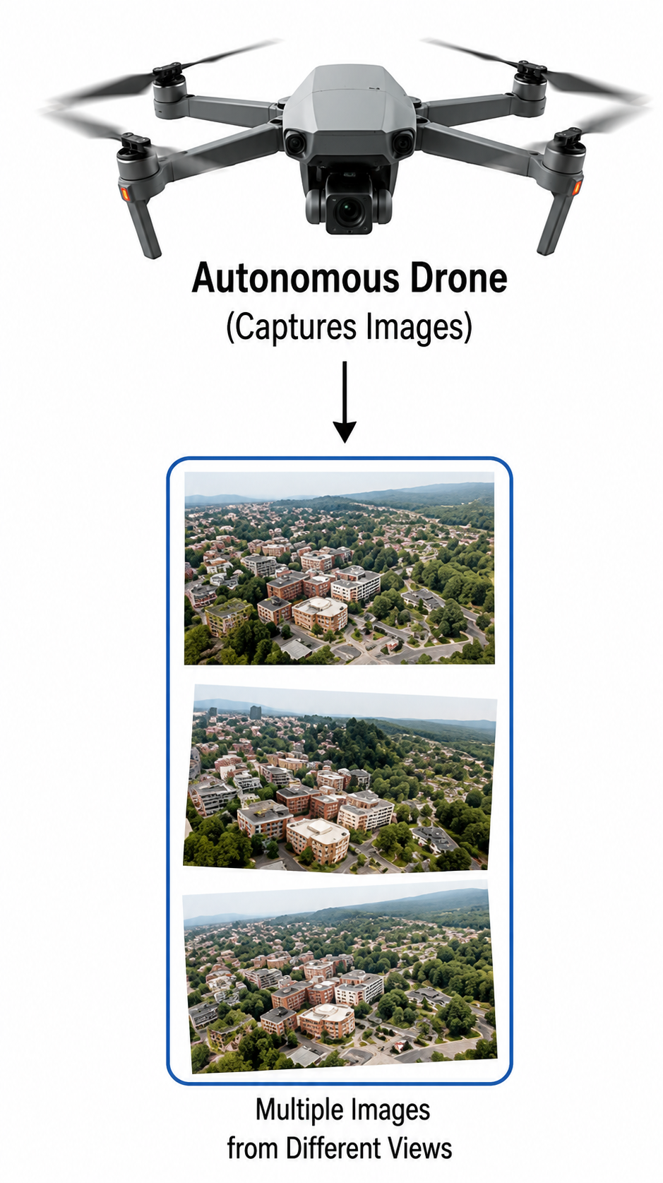
SYSTEM ARCHITECTURE OF AUTONOMOUS DRONE 3D RECONSTRUCTION SYSTEM
Multiple View Geometry
Feature Correspondence
Camera Pose Estimation
Triangulation
Image Formation
Perspective Projection
3D Scene → 2D Image
Image Generation
Camera Model
Focal Length
Sensor Geometry
Lens Parameters
Binocular Vision
Stereo Image Pair
Feature Matching
Depth Estimation
Drone Image Acquisition
Capture Multiple Images
Different Viewpoints
Aerial Images Collection
Camera Calibration
Intrinsic Parameters
Extrinsic Parameters
Distortion Correction
3D Reconstruction
Point Cloud Generation
Mesh Creation
Texture Mapping
Output
Depth Map
3D Model
Reconstructed Scene
Digital Twin

